Slide 1
Data and Information
All computer processing requires data, which is a collection of raw facts, figures and symbols, such as numbers, words, images, video and sound, given to the computer during the input phase.
Computers manipulate data to create information. Information is data that is organized, meaningful, and useful.
During the output Phase, the information that has been created is put into some form, such as a printed report.
The information can also be put in computer storage for future use.

Slide 2
Types of Data
1. Text
Examples
Word processing (Formatted)
Dictionary
2.Picture or Image
Examples
Finger print Recognition
House plan
Photo albums

Slide 3
3. Audio Data
- Examples
Flight Data Recorders
Black Box
Digital Audio recording
Music Synthesis
To synthesize music using basic tunes
Using innovative ideas resulting in interesting new tunes
Internet Telephone
- Transmitted using WAN

Slide 4
4. Video Data
- Movie Applications
- Image Morphing
- applying series of transformations and changing from frame to frame
Representation of Data
Deals with how the stored data deals efficiently for interpretation by the hardware (internal representation)
External representation (Human understanding)

Slide 5
Numeric Data
Using various number systems
Eg. Decimal, Binary, Octal, Hexa decimal.
2. Text Data
- Coding of characters has been standardized
- Used to facilitate exchange of recorded data between computers
- One of the most popular Standard is ASCII.
- American Standard Code for Information Interchange
- Uses 7 bits to code each character
- ASCII code is available for both printable and non-printable characters
- Non printable characters such as End of Line, End of Page etc.,

Slide 6
- Another code known as ISCII
-Indian Standard Code for Information Interchange has been standardized by the Bureau of Indian Standards.
- It is an 8-bit code and retains the standard ASCII code for english.
- Recently a new coding scheme for characters called Unicode.
- Unicode designed to accommodate a large number of special symbols.

Slide 7
It uses 2 bytes to represent each character
Unicode have however defined codes from 0000 to FFFD in hexadecimal which is 65534 codes ( 2 less than 65536 = 2¹⁶).
Any character of any language in the world can be represented with this large number.
First 128 characters of unicode are identical to ASCII codes.
Unicode is compatible with existing ASCII and ISCII coded data stored in computers.

Slide 8
3. Audio Data Representation
There are a number of different types of Audio files. The most common are Wave files (wav) and MPEG Layer-3 files (mp3).
There are, however, many other audio file types discussed below. For example, ".wav", ".mp3“.
A codec ("coder/decoder") is a way of encoding audio or video into a stream of bytes.

Slide 9
The way the audio is compressed and stored is call the codec which determines how small the file size is. Some file types always use a particular codec. For example, ".mp3" files always use the "MPEG Layer-3" codec.
wav - standard audio file format used mainly in Windows PCs Waveform Audio File Format (WAVE, or more commonly known as WAV due to its filename extension)^{[3][6][7][8]} (rarely, Audio for Windows^{[9]}) is a Microsoft and IBM audio file format standard for storing an audio bitstream on PCs. It is an application of the Resource Interchange File Format (RIFF) bitstream format method

Slide 10
FLAC ( Free Lossless Audio Codec) is an audio coding format for lossless compression of digital audio, and is also the name of the reference codec implementation. Digital audio compressed by FLAC's algorithm can typically be reduced to 50–60% of its original size^{[4]} and decompressed to an identical copy of the original audio data.

Slide 11
FLAC is an open format with royalty-free licensing and a reference implementation which is free software. FLAC has support for metadata tagging, album cover art, and fast seeking.
Though FLAC cannot store floating-point data, and playback support in portable audio devices and dedicated audio systems is limited compared to lossy formats such as MP3 or uncompressed PCM, FLAC is supported by more hardware devices than competing lossless compressed formats such as WavPack. .
But we recommend flac for archiving PCM files where quality is important (eg. broadcast or music use).

Slide 12
gsm - designed for telephony use in Europe, gsm is a very practical format for telephone quality voice
GSM Global System for Mobile Communications
Full Rate (FR or GSM-FR or GSM 06.10 or sometimes simply GSM) was the first digital speech coding standard used in the GSM digital mobile phone system.
The bit rate of the codec is 13 kbit/s
The quality of the coded speech is quite poor by modern standards, but at the time of development (early 1990s) it was a good

Slide 13
Gradually Full Rate - GSM will be replaced by Enhanced Full Rate (EFR) and Adaptive Multi-Rate (AMR) standards, which provide much higher speech quality with lower bit rate.
Like many other speech codecs, linear prediction is used in the synthesis filter. However, unlike most modern speech codecs, the order of the linear prediction is only 8. In modern narrowband speech codecs the order is usually 10 and in wideband speech codecs the order is usually 16.

Slide 14
Audio Interchange File Format (AIFF) is an audio file format standard used for storing sound data for personal computers and other electronic audio devices. The format was developed by Apple Inc. in 1988 based on Electronic Arts' Interchange File Format (IFF, widely used on Amiga systems) and is most commonly used on Apple Macintosh computer systems.

Slide 15
The audio data in a standard AIFF file is uncompressed pulse-code modulation (PCM). There is also a compressed variant of AIFF known as AIFF-C or AIFC, with various defined compression codecs.
Unlike the better-known lossy MP3 format, AIFF is uncompressed (which aids rapid streaming of multiple audio files from disk to the application), and is lossless. Like any uncompressed, lossless format, it uses much more disk space than MP3—about 10MB for one minute of stereo audio at a sample rate of 44.1 kHz

Slide 16
au - the standard audio file format used by Sun, Unix and Java.

Slide 17
raw - a raw file can contain audio in any codec but is usually used with PCM audio data. It is rarely used except for technical tests.
4. Video Data Representation
Video formats are confusing because most video files have at least two different types: the container, and the codec(s) used inside that container.
The container describes the structure of the file: where the various pieces are stored, how they are interleaved, and which codecs are used by which pieces. It may specify an audio codec as well as video.

Slide 19
A codec ("coder/decoder") is a way of encoding audio or video into a stream of bytes. Common Container Formats:
AVI (.avi): Most commonly contains M-JPEG (especially from digital cameras?) or DivX (for whole movies)
WMV (.wmv): More or less MPEG4; can contain nearly any codec
ASF ("Advanced Streaming Format", .asf): a subset of wmv, intended primarily for streaming: an early Microsoft implementation of an MPEG4 codec.

Slide 20
Common Codecs:
MPEG ("Moving Pictures Expert Group"): three video formats, MPEG 1, 2, and 4.
MPEG-1: Old, supported by everything (at least up to 352x240), reasonably efficient. A good format for the web.
MPEG-2: A souped-up version of MPEG-1, with better compression. 720x480. Used in HDTV, DVD.
MPEG-4: A family of codecs, some of which are open, others Microsoft proprietary.
Sorenson 3: Apple's proprietary codec, commonly used for distributing movie trailers (inside a quicktime container).
Quicktime 6: Apple's implementation of an MPEG4 codec.

Slide 21
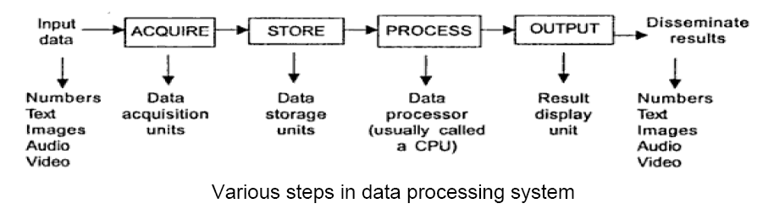
Data Acquisition and Processing
Information Technology is concerned with
Acquisition of data
Storage of data
Organization of data
Processing of data
Output of processed data
Dissemination or distribution of information

Slide 22
Numeric Data Representation
Decimal number system
- digits (or symbols) allowed: 0-9
base (or radix): 10
- the order of the digits is significant 345 is really
3 x 10**2 + 4 x 10**1 + 5 x 10**0
3 x 100 + 4 x 10 + 5 x 1
Here 3 is the most significant symbol (it carries the most weight)
Here 5 is the least significant symbol (it carries the least weight)

Slide 23
Binary number system:
digits (symbols) allowed: 0, 1
base (radix): 2
each binary digit is called a BIT
the order of the digits is significant numbering of the digits
msb lsb
n-1 0
where n is the number of digits in the number
Binary to Decimal
1001 (base 2) is really
= 1 x 2**3 + 0 x 2**2 + 0 x 2**1 + 1 x 2**0
= 9 (base 10)

Slide 24
octal number system:
digits (symbols) allowed: 0-7
base (radix): 8
the order of the digits is significant
Octal to Decimal
345 (base 8) is really
= 3 x 8**2 + 4 x 8**1 + 5 x 8**0
= 192 + 32 + 5
= 229 (base 10)

Slide 25
hexadecimal number system:
digits (symbols) allowed: 0-9, a-f
base (radix): 16
the order of the digits is significant
Decimal 0 .. 9
Hexa Decimal 0 .. 9
Decimal 10 .. 15
Hexa Decimal a .. f
Hexa Decimal to Decimal
a3 (base 16) is really
= a x 16**1 + 3 x 16**0
= 160 + 3
= 163 (base 10)

Slide 26
decimal --> binary
divide decimal value by 2 (the base) until the value is 0
example:
36/2 = 18 r=0 <-- lsb
18/2 = 9 r=0
9/2 = 4 r=1
4/2 = 2 r=0
2/2 = 1 r=0
1/2 = 0 r=1 <-- msb
36 (base 10) == 100100 (base 2)

Slide 27
binary --> octal
1. group into 3's starting at least significant symbol (if the number of bits is not evenly grouped by 3, then add 0's at the most significant end)
2. write one octal digit for each group
example1: 100 010 111 (binary)
4 2 7 (octal)
example 2: 10 101 110 (binary)
010 101 110 (added 0 in MSB)
2 5 6 (octal)

Slide 28
binary --> hex
(just like binary to octal!)
1. group into 4's starting at least significant symbol (if the number of bits is not evenly grouped by 4, then add 0's at the most significant end)
2. write 1 hex digit for each group
example 1:
1001 1110 0111 0000 (Binary)
9 e 7 0 (Hexa)
example 2:
1 1111 1010 0011 (Binary)
0001 1111 1010 0011 (Added 0 in the MSB)
1 f a 3 (Hexa)

Slide 29
hex --> binary
(trivial!) just write down the 4 bit binary code for each hexadecimal digit
example:
3 9 c 8 (Hexa)
0011 1001 1100 1000 (Binary)
octal --> binary
(just like hex to binary!) (trivial!) just write down the 3 bit binary code for each octal digit

Slide 30
hex --> octal
do it in 2 steps,
hex --> binary --> octal
decimal --> hex
do it in 2 steps,
decimal --> binary --> hex

Slide 31
Acquisition of textual data
Textual data may be printed, typed or handwritten.
• Any type of text can be acquired by manually typing it using a keyboard attached to a computer. However it is slow, error prone and expensive.
• The standard method us to use a scanner to acquire a textual data.
Types of scanner
–Flat-bed scanners
•Scanner head moves over the paper.
•More expensive, more accurate.
–Sheet-fed scanners
•A scanner that allows only paper to be scanned rather than books or other thick objects.
•It moves the paper across a stationary scan head.

Slide 32
– Drum scanners
•Scanner is fixed and the paper moves.
•It capture image information with photomultiplier tubes (PMT), rather than the charge-coupled device (CCD) arrays
•More expensive, more accurate.
– Hand-held scanners
•Scanner moves over the paper section by section.
•Less expensive

Slide 33
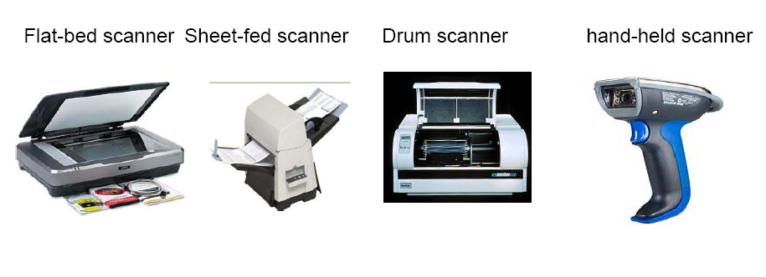
Parts of a Scanner
•An optical system consists of a light beam, lens, mirror
•An array of solid state “electronic eyes” known as CCD (Charge coupled Device) array. It sense light and give as electrical output.
•An electronic circuit which converts the electrical output given by the array of “electronic eyes” to a set of bits that are stored in the computer memory.

Slide 34
Working of a scanner
• Fluorescent light moves over the page.
• The light is reflected.
• The reflected light beam picked up by the CCD array called as picture element (pixel).
• CCD measures the brightness of every pixel and assigns a value.
• These values are stored as index or palette numbers.
• The scanner with 300 CCD elements per inch in X direction and 600 scan lines per inch in Y-direction store 300 * 600 = 180,000 pixels per square inch. The scanned version of the text called as bit maps.
• A 7"* 9"text area with resolution of 300 * 600 bpi require (7*300*9*600) bits of storage area.

Slide 35
Drawbacks of bit map representation and an alternate
• It requires a huge storage area.
• As individual characters are not stored, it is impossible to search the text for character strings.
• A software called OCR (optical character recognition) is used to recognize bit map characters and get their ASCII equivalent.
• OCR compare each scanned letter with a sample set stored in a computer and find a match.
• It is used to reduce the storage space and helps to find the keywords in text.

Slide 36
The storage needed to store 24 lines of 80 characters is 1920 bytes, that is much smaller than 1.4MB needed by a bit map representation.
• OCR gives accuracy around 98% with printed and typed text
.•For hand-written characters, OCR is not acceptable as error rates are high.
- Refer other downloaded contents (Captricity, others)
Acquisition of pictures
Pictures can be classified as
Line-drawing
Black and white two-tone pictures
Black and white Multi-tone images with several grey levels
Colour pictures

Slide 37
Line drawings acquired using a graphic tablet if the lines described as straight lines, arcs of circles, ellipses.
The coordinates of vertices along with the nature of the curve connecting the vertices are stored.
With this method the storage needed is small and the line drawing can be constructed for processing or printing.
A two-tone pictures such as handwritten text, black and white cartoons are acquired using a scanner. It is stored as a bit map with 1 bit storage per pixel.

Slide 38
A multi-tone pictures also scanned with the same scanner but each pixel is stored as a byte can represent 256 levels of grey.
A 7 * 9 size picture need 300 * 600 * 7 * 9 * 8 bits = 90.72 Mb.
A multi-colour image uses three colours –Red, Green and Blue in appropriate proportions to represent each pixel.
A scanner codes a colour picture using a 24 bits per pixel, one byte per colour.

Slide 39
The value of the byte represents the intensity of the colour.
If 3 bytes are combined, we get 16 million colours.
A Digital camera also used to acquire pictures.
A digital camera uses the lens system of a normal film camera.
Instead of a film, a CCD array is used to sense the image.
A mosaic or mixture of colour (red,green,blue) filters are used to capture colour pictures.

Slide 40
Storage formats for pictures
Uncompressed image is stored either bmp or tif (Tagged image file) file format.
Uncompressed image file requires large-several megabytes.
So image files are normally compressed before they are stored and decompressed when the image is displayed.
Two main principles used to compress are to reduce redundant pixels in images and eliminate pixels which human can't see.

Slide 41
Two primary compression methods are GIF (Graphical Interchange Format) and JPEG (Joint Photographic Experts Group) format.
The method used to compress images in GIF is called statistical compression. It codes the most frequently occurring pixels by shorter bit strings.
JPEG compression transforms image to another form and remove the information that is not significantly needed for the image appearance. This is called as lossy compression.

Slide 42
GIF
is a Bit map image format that was introduced by Compuserve in 1987 by replacing their earlier run-length encoding (RLE) format, which was black and white only.
GIF images are compressed using the Lempel-Ziv-Welch (LZW) lossless data compression technique to reduce the file size without degrading the visual quality.
This compression technique was patented in 1985

Slide 43
The advantage of LZW compression is even fairly large images can be downloaded in a reasonably short time, even with very slow modems.
The original version of the GIF format was called 87a. In 1989, CompuServe released an enhanced version, called 89a, which added support for animation delays (multiple images in a stream were already supported in 87a), transparent background colors, and storage of application-specific metadata.

Slide 44
The animation-delay property defines when the animation will start.
The animation-delay value is defined in seco
GIF was one of the first two image formats commonly used on Web sites, the other being the black and white ? (find name and characteristics)

Slide 45
The feature of storing multiple images in one file, accompanied by control data, is used extensively on the Web to produce simple animations.
The optional interlacing feature, which stores image scan lines out of order in such a fashion that even a partially downloaded image was somewhat recognizable, also helped GIF's popularity,
Interlacing (also known as interleaving) is a method of encoding a bitmap image such that a person who has partially received it sees a degraded copy of the entire image.

Slide 46
JPEG uses a lossy form of compression based on the discrete cosine transform (DCT).
The compression method is usually lossy, meaning that some original image information is lost and cannot be restored, possibly affecting image quality. There is an optional lossless mode defined in the JPEG standard. However, this mode is not widely supported in products(Why?)

Slide 47
There is also an interlaced "Progressive JPEG" format, in which data is compressed in multiple passes of progressively higher detail.
This is ideal for large images that will be displayed while downloading over a slow connection, allowing a reasonable preview after receiving only a portion of the data. However, support for progressive JPEGs is not universal.

Slide 48
JPEG XR (abbr. for JPEG extended range) is a still-image compression standard and file format for continuous tone photographic images, based on technology originally developed and patented by Microsoft under the name HD Photo (formerly Windows Media Photo). It supports both lossy and lossless compression.
The most common continuous tone images are digital photographs. Film is a halftone medium.

Slide 49
Acquisition of Audio
• Unlike text and pictures audio signal has time as an explicit variable. It is continuous function of time.
• The sound waves are converted by electrical voltage that continuously varies with time and it is called as analog signal (continuously varying signal).
•An analog signal is digitized by picking samples at regular intervals and represent these samples by their digital equivalents.
•For speech,6250 samples per second and 8 bits per sample are adequate.
•For music, 44100 samples per second and 16 bits per sample are needed.

Slide 50
Analog signal are converted to a sequence of bits using a device called A/D converter. Digitized audio signals are converted back to audio signal using a device called D/A converter.
•PCs equipped with sound card used to convert audio signals to digital form and stored in a .wav file extension.
•Compression of .wav file is done by the processor using the MP3 compression algorithm. It compresses the number of bits in an audio signal by a factor of 10 to 14.
•MP3 audio players are available in the market to play MP3 compressed digital audio signal.
use a microphone and a sound card to collect sound level data

Slide 51
A sound card (also known as an audio card) is an internal computer expansion card that facilitates the input and output of audio signals to and from a computer under control of computer programs.
An important sound card characteristic is Polyphony , which refers to its ability to process and output multiple independent voices or sounds simultaneously.
These distinct channels are seen as the number of audio outputs, which may correspond to a speaker configuration such as 2.0 (stereo), 2.1 (stereo and sub woofer), 5.1 (surround).

Slide 52
Later cards, such as the AdLib sound card, had a 9-voice polyphony combined in 1 mono output channel.
The full capabilities of advanced cards are often not fully used; without DOWNMIX only one (mono) or two Stereo voice(s) and channel(s) are usually dedicated to playback of digital sound samples, and playing back more than one digital sound sample usually requires a software DOWNMIX at a fixed sampling rate.
Downmixing is a general term used for manipulating audio where a number of distinct audio channels are mixed to produce a lower number of channels. It is also known as fold-down

Slide 53
Modern low-cost integrated soundcards (i.e., those built into motherboards) such as audio codecs like those meeting the
AC ’97 standard. (? – aim and characteristics of AC 97)
Use of Sound card
The main function of a sound card is to play audio, usually music, with varying polyphonic formats (monophonic, stereophonic, various multiple speaker setups) and degrees of control. The source may be a CD or DVD, a file, streamed audio, or any external source connected to a sound card input.

Slide 54
Acquisition of video
•A video camera acquire a moving picture by scanning a frame from left to right starting from the top left corner and ending at the bottom right corner.
•The scanning is repeated at least 30 times per second to represent motion.
• Colour and intensity of each spot scanned is acquired by CCD.
•640 * 480 pixels per frame are needed for good video quality. For monochrome picture 8 bits are used to represent one pixel requires 9.216 MB per second.
• For Colour picture each pixel needs 3 bytes (24 bits) to represent colour. The total number of bytes per second generated by colour video camera is 27.648 MB.A two hour video needs 200 GB.

Slide 55
It requires enormous amount of storage to store the digitized video, also it leads to difficulty in transmission and display.
It is thus essential to compress the digital video data.
• In video compression each image frame is first compressed using JPEG compression.
• In most videos, a large portion of the background image does not change, movement is limited to a small part of an image. This fact is exploited in video compression.
• A group of pictures (around 20) are taken. It is known as Group of pictures (GOP).

Slide 56
In Video coding , a group of pictures, or GOP structure, specifies the order in which intra and inter frames are arranged. (Find difference intra and inter frame ?)The GOP is a group of successive pictures within a coded video stream. Each coded video stream consists of successive GOPs. From the pictures contained in it, the visible frames are generated.
The I frames contain the full image and do not require any additional information to reconstruct it. Typically, encoders use GOP structures that cause each I frame to be a "clean random access point", such that any errors within the GOP structure are corrected by the next I frame.

Slide 57
P picture or P frame(predictive coded picture) – contains motion compensated difference information relative to previously decoded pictures.
Motion compensation is an algorithmic technique used to predict a frame in a video, based on the given accounting information i.e previous and/or future frames in the video.
Motion compensation describes a picture in terms of the transformation of a reference picture to the current picture. The reference picture may be previous in time or even from the future.

Slide 58
When images can be accurately synthesized from previously transmitted/stored images, the compression efficiency can be improved.
It is employed in the encoding of video data for video compression , for example in the generation of MPEG-2 files.
The GOP structure is often referred by two numbers, for example, M=3, N=12. The first number tells the distance between two anchor frames (I or P). The second one tells the distance between two full images (I-frames)

Slide 59
A starting image is used as a reference for the group. The difference in pixel values of corresponding points in the GOP is much smaller than the number of bits used per pixel. This idea is used to encode other images in group to achieve video compression.
• MPEG -2 provides the compression ratio by a factor of 100 to 150.
• A set of MPEG standards are used to compress video.
MPEG-1 used for normal TV and VDU.
MPEG-2 is used for High definition digital TV.
MPEG-4 is used in WWW applications that uses low speed data transmission paths.

Slide 60
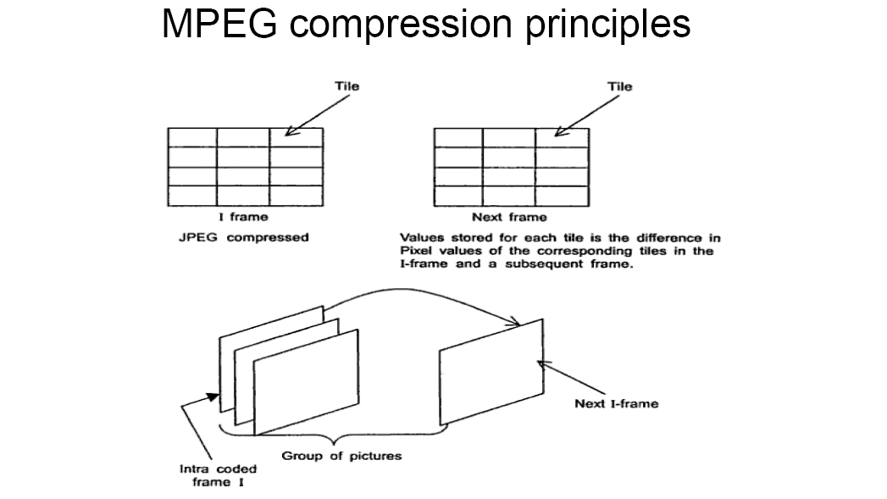

Slide 61
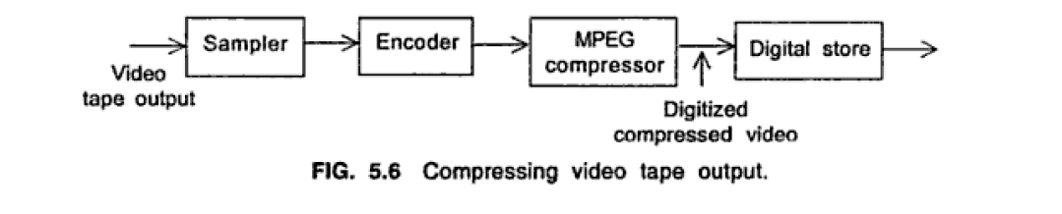

Slide 62
Advantages of digitizing video
Digitizing video provides better image quality.
It provides random access to any specified image.
It makes editing of the information in the video disk is easy.
Digital video provides major applications called as video-on-demand systems which will deliver high quality entertainment, education and sports video from digital video stores to home TV’s

Slide 63
Processing numerical data
• The earliest use of computers was in numerical computation. It means the data to be processed are numbers and the operations performed are arithmetic operations.
•The major applications that require numerical processing are:
i) statistical computations –e.g. finding the average age of students in a class, the percent population in different income group, global rainfall statistics.
ii) Solving science and engineering problems -It involves operation of calculus such as differentiation, integration, solutions to differential equations.
iii) Solution to business and economics problem e.g. payments in installment purchase, preparing invoices, daily ledger accounts.

Slide 64
PC based program called spread sheet is used for this applications.
• Spreadsheet is a readymade packaged program. It has rich set of built-in function and is easy to use.
•It facilities to print graphs, bar charts, pie charts that helps to visualize results and understand their significance.

Slide 65
Processing and displaying textual data
•Most commonly used applications to process textual data is word processor.
•Word processor is a program which allows us to enter text using the keyboard, edit it, correct spelling errors, format it in paragraphs & pages, to use different fonts, to highlight certain words in the text.
• Word processors allow us to creation of composite documents with pictures, line drawings, tables and allow to create personalization of form letters, merge address labels.
• Popular word processing software are MS-Word by Microsoft with different updates.
• Desktop publishing (DTP) refers to word processing coupled with printing of the formatted document using a high resolution LaserJet printer.

Slide 66
DTP is now routinely used to compose books, newsletters, journals and daily newspapers. Special feature in DTP
•Embedding graphics in material.
•Embedding scanned pictures
•Printing in multiple columns
• The page layout on screen gives a good indication of what the printed result will look like. This is called WYSIWYG –What You see Is What You Get.
• Facility to print a number of different character sets and mathematical symbols.
• Eg software –page maker, Adobe In Design

Slide 67
Printing the output of word processor or DTP are done by the language called Page Description Languages (PDL).
• A popular PDL is called post script that has been accepted by all laser printer manufactures. A word processor file with .ps extension is used to identify a PostScript file.
• Portable document format (PDF) is a file format designed to publish and distribute computer generated documents to diverse computers that is connected to internet.
• PDF was defined by a company called adobe. It can be viewed by PDF viewer. Word documents are converted to PDF using a software called PDF writer.
• Rich TextFormat (RTF) was promoted by Microsoft. Documents created using RTF are machine and operating system independent.
• Markup languages add tags to documents which assign special meaning to various character string used in the document.

Slide 68
Markup Languages describe the structure and content of documents.
•Standard Generalized Markup Languages(SGML) is an international open standard that is independent of a computer hardware and operating system.
•Two mark up language developed from SGML called HTML and XML.
•Hypertext Markup languages(HTML) is used to create visually appealing presentation of a document to a reader, incorporate graphics, links to other parts of the web documents and web pages stored in other sites.
•Extensible Markup language(XML) allows users to design their own document types appropriate for the intended audience by using tags.
•XML is used in many applications such as on-line banking, software update distribution and e-commerce.

Slide 69
Processing multimedia data
•Image data processing are divided into 3 broad categories.
•Image processing
•Image generation
•Image recognition
•Image processing is used to edit the images. Editing consists of erasing certain parts of an image, combining two images, changing colours etc. Graphic tools like paint –Microsoft program, Adobe’s Photoshop and Corel photo-paint are available to perform this tasks on a PC.
•Image generation consists of creating pictures using primitive components such as straight lines, circles, ellipses, polygons. This type of generation of geometric objects called vector graphics. It is used to create engineering design drawing called computer aided design (CAD).

Slide 70
•AUTOCAD is most popular CAD tool used to view different aspects of an objects.
•Wire frame is a 3D drawing of the outline of the object. It is the skeleton of an object.
•Shading is the process of giving appearance of a surface by using appropriate colour.
•Texture mapping gives a natural appearance such as fabric, rough surface, shiny surface.
•Ray tracing is a shading method simulates illumination of objects from different angles. E.g shadow of a house or shadow of objects in lighted room.
•Morphing is a transformation of an image gradually from a starting image to a concluding image.

Slide 71
Image recognition consists of understanding the nature of an image
and classifying it.
Example recognizing a face, recognizing and classifying finger-prints and identifying a specified objects from a group of objects.
• Image recognition can be used from criminal investigations to training robots to pick up specified objects.
• Time varying images constitute a video.
Video processing consists of editing videos using primitives such as cutting, pasting, erasing, enhancing image.
• Generating videos consists of two interesting operations known as morphing and animation.
• Morphing is transformation of an image gradually from a starting image to a concluding image using a sequence of intermediate pictures. In order to simulate smooth change, some parts of the image are fixed and others change gradually.
Animation is the process of generating a seemingly moving picture by changing a sequence of still picture at the rate of at least 30 per second.
• Animation sequence is created by artists drawing a number of still pictures either manually or by using a computer program.

Slide 72
Major graphics application are computer games, tools for computer aided design of engineering systems, computer animation for movies and cartoons and advertisements.
• Audio data processing consists of modifying digitized sound files to remove noise (digital re-mastering), enhance sound quality (bass enhancement), add special effects to existing sound files, editing audio files by cutting and pasting.
• All the above types of audio processing done with a multimedia PC equipped with a sound card and loudspeaker.
• Audio processing applications
–Generating or synthesizing audio file using primitive sound patterns (work on phonology)
–Speech synthesis
–Speech analysis and recognition

Slide 73
•Generation of audio
–To generate or synthesize audio a music synthesizer are connected to a PC using a interface known as Musical Instrument Digital Interface (MIDI).
•Speech synthesis
– Programs are available to convert textual input to spoken output. It uses idea of combining letters to pronounce words.
•Speech analysis and recognition
–Recognizing a speaker from a sample of speech and converting a spoken sentence to ASCII text.
–E.g. password like system to allow access to a building or to database stored in a computer.

Slide 74
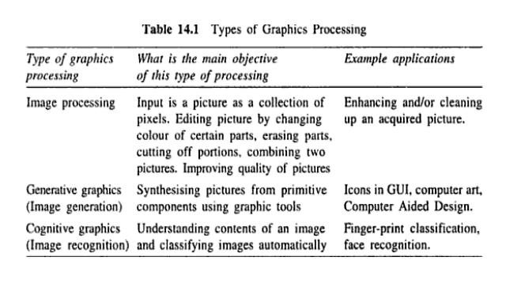

Slide 75
Business information system
Introduction
•Applications of computers
•all organizations like –government offices , academic institutions, businesses, road transport services, railways, airlines etc., -use IT.
–Tasks carried out by a computer –software.
•Eg1: Commercial –Medical shop –Billing system.
•Eg2: Computerized Railway reservation system –tickets issued per day

Slide 76
TYPES OF INFORMATION NEEDED BY
ORGANIZATIONS
1. OPERATIONAL INFORMATION :
–Information needed to run business day-to –day.
–With ref. to Eg1 :
No. of bills produced per day
Items whose stock is low and new order to be placed
Information about reliability of suppliers
Profit and loss account
–With ref. to Eg2 :
•No of tickets issued per day
•Amount collected at each station
•Reservation chart
•Cancellations of tickets

Slide 77
2. TACTICAL INFORMATION :–Information needed to take short range decision to run a business efficiently.
–With ref. to Eg1 :•Information on reliability of suppliers –management decision how to select suppliers.
–With ref. to Eg2 :•Examine which train have long waiting lists and add bogies to clear the rush or schedule special trains.

Slide 78
3. STRATEGIC INFORMATION :
–Information needed for long range planning and steering the business to increase profit.
–With ref. to Eg1 :
•Expanding the business by stockings –equipments
•Discounts on sales
•Open a new branch
–With ref. to Eg2 :
•double the tracks
•Electrify certain routes
•Convert meter gauge into broad gauge

Slide 79
STATUTORY INFORMATION :
–Information and reports which are required by law to be sent to government authorities , periodical submission is important.
With ref. to Eg1 :
–Filing sales tax returns , income tax returns
With ref. to Eg2 :
–Submission of annual budget to Parliament

Slide 80
Why should we use computers in Businesses ?
•The volume of data becomes large when the organization grows. It becomes difficult to process them manually.
•Computer based processing enables the same data to be processed in many ways based on needs.
•Markets are becoming competitive and globalization.
•Computers have proven to be invaluable aids in efficiently producing goods and managing organizations.

Slide 81
Why should we use computers in Businesses ?
•The volume of data becomes large when the organization grows. It becomes difficult to process them manually.
• Computer based processing enables the same data to be processed in many ways based on needs.
•Markets are becoming competitive and globalization.
•Computers have proven to be invaluable aids in efficiently producing goods and managing organizations.

Slide 82
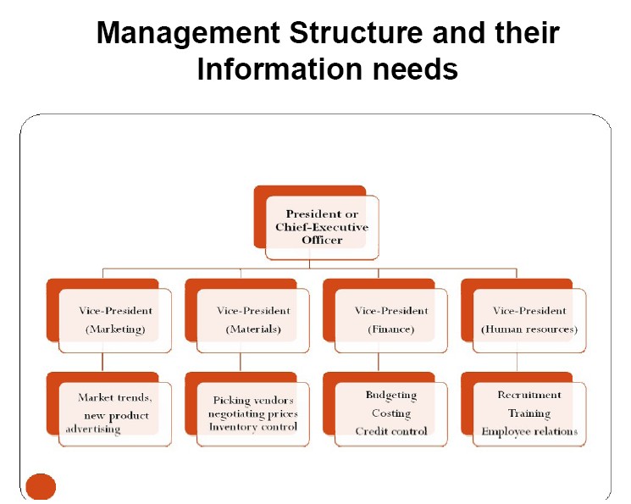

Slide 83
Management Structure and their Information needs…Cont.,
Management Information System (MIS) :
–The system which uses operational data and applies a number of rules and summarizes them to obtain information relevant for taking tactical decisions is known as a Management Information System.

Slide 84
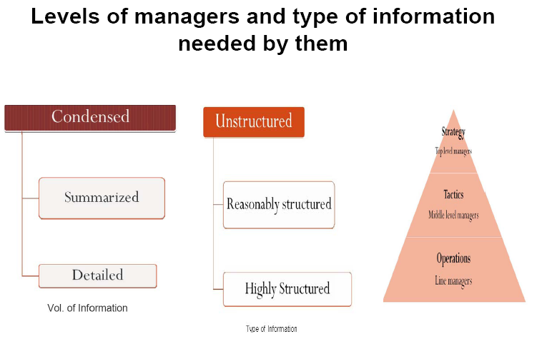

Slide 85
Management Structure and their Information
needs…Cont.,
• Operational data collected over a long period is called
data archives and the process of collecting operational data is called data archiving.
•Analyzing archived data to observe patterns which
assist in management decision-making is called data
mining.
•Strategic information for decision-making by top
management is obtained by what is known as Decision Support System.

Slide 86
Design of an Operational Information System
Example : medical store–The operations to be performed by the computer based system are:
To print a bill
To keep a database containing updated stock position
3. Initiate reorder when stock of a specified medicine goes below a certain value
4. Prepare a list of medicines in stock –expiry date

Slide 87
Design of an Operational Information System…Cont.,
Tasks to be done to create the system
Step 1: Creating master file of inventory
Step 2 : Editing and storing the database on on-line hard disk
Step 3: Processing customer request

Slide 88
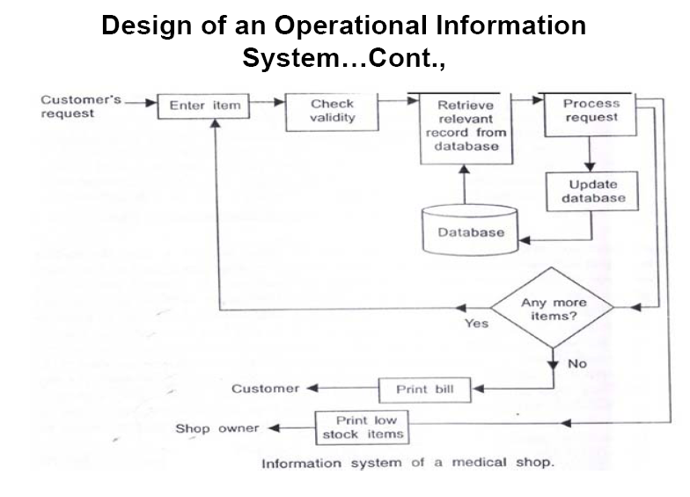

Slide 89
SYSTEM LIFE CYCLE
•Development of information system for businesses is a complex job hence it can be broken in to a number of phases.
•Each phase has a conclusion and a report is written when the phase is completed –Convenient milestone.

Slide 90
